Slide 1
BAKERY SALES ANALYSIS PRESENTED BY ARULMOZHI K ., DA/DS , MILESTONE 01 PYTHON DATA EXPLORATION PROJECT

Slide 2
DATA WORKFLOW
Import dataset
load the dataset
Data understanding
Data cleaning
Data analysis
Data visualization

Slide 3
Introduction
The EDA process for a bakery sales dataset typically involves understanding the structure of data , cleaning it and performing various analysis to uncover trends , patterns, and relationships that can be used for insights and for further modelling
Variables involved :
Transaction no.
Items
Date and time
Day part
Day type

Slide 4
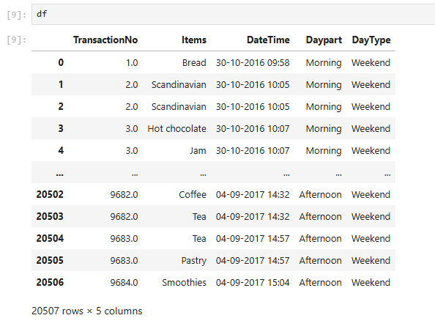
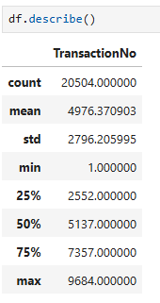
DATA UNDERSTANDING
Number of rows and columns : 20507 X 5
Data types : object , float
Summary statistics:

Slide 5
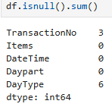
INITIAL EXPLORATION
Missing values
Handling missing values

Slide 6
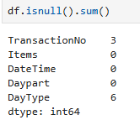
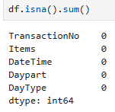
BEFORE AND AFTER COMPARISON

Slide 7
OUTLIER HANDLING
outliers and duplicates values are not found in this dataset.

Slide 8
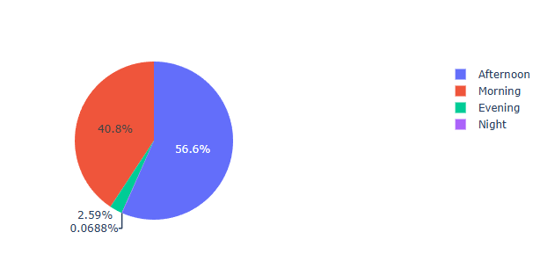
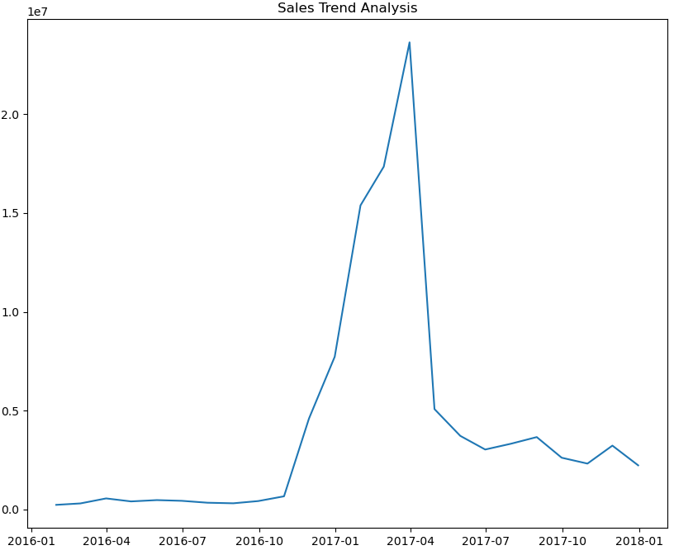
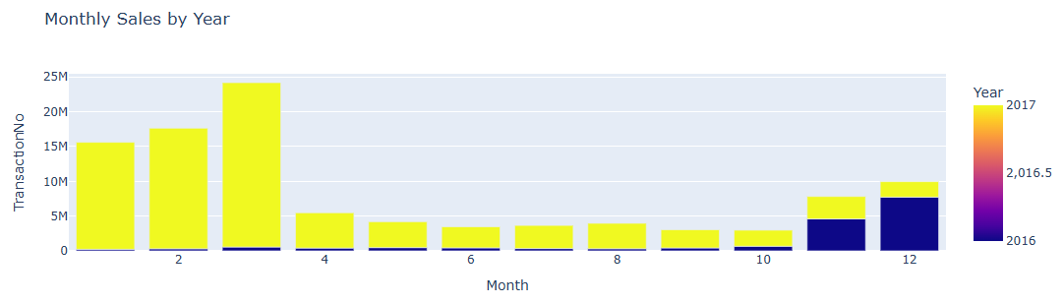
DATA VISUALIZATION

Slide 9
thank you

